Slide 1


Raghad Alasmari
Study Squad
An easier way to connect students with tutors around the world !

Slide 2


Students Problems
Statistics
Outlines
Why Study Squad?
Tools
Figma
PostMan

Slide 3

Students Problems
Difficulty finding tutors
Difficulty estimating the tutor's efficiency
High prices with few tutors
Difficulty trusting anonymous tutors
Deception and fraud

Slide 4
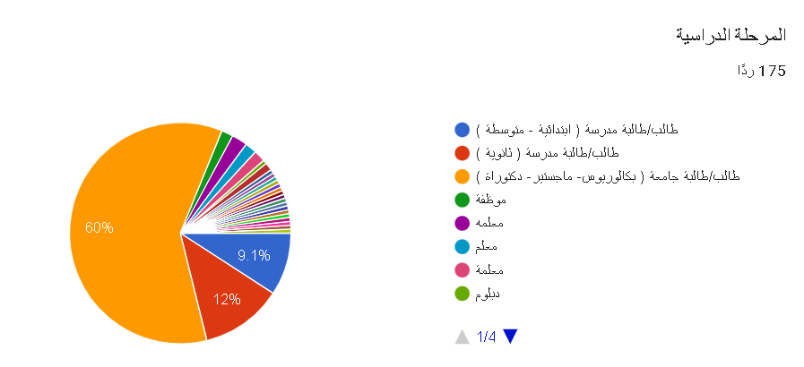


Statistics
Raghad Alasmari

Slide 5
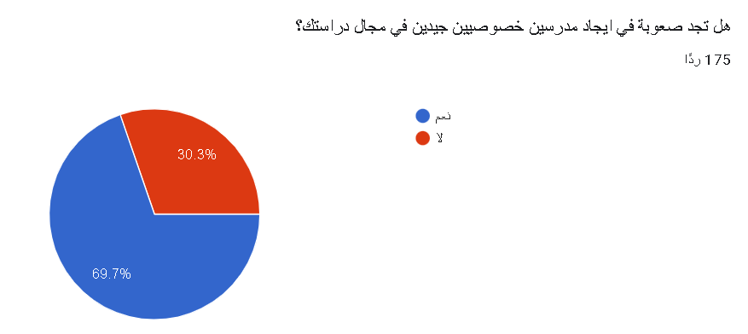
Statistics
Raghad Alasmari

Slide 6
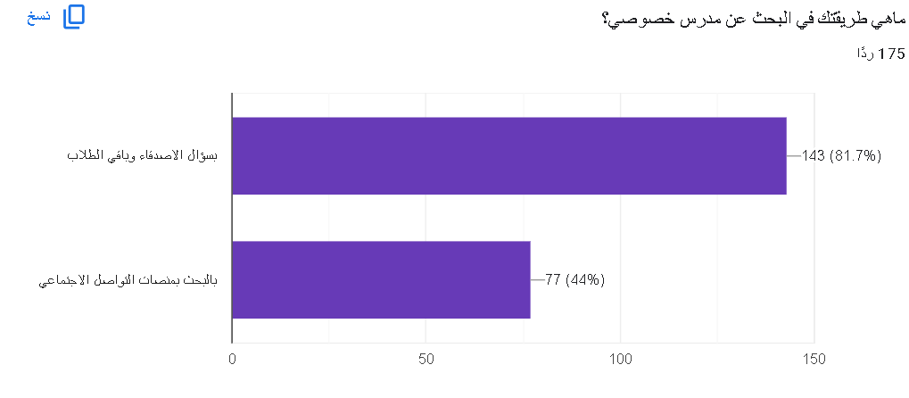
Statistics
Raghad Alasmari

Slide 7
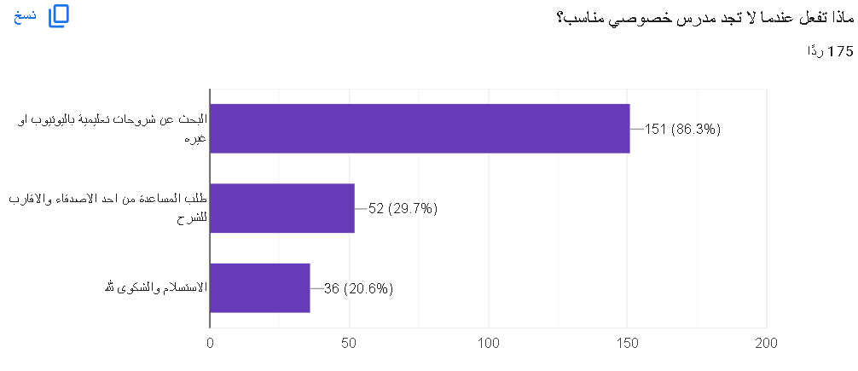
Statistics
Raghad Alasmari

Slide 8
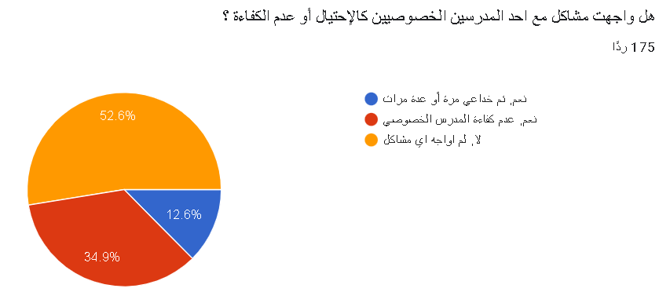
Statistics
Raghad Alasmari

Slide 9
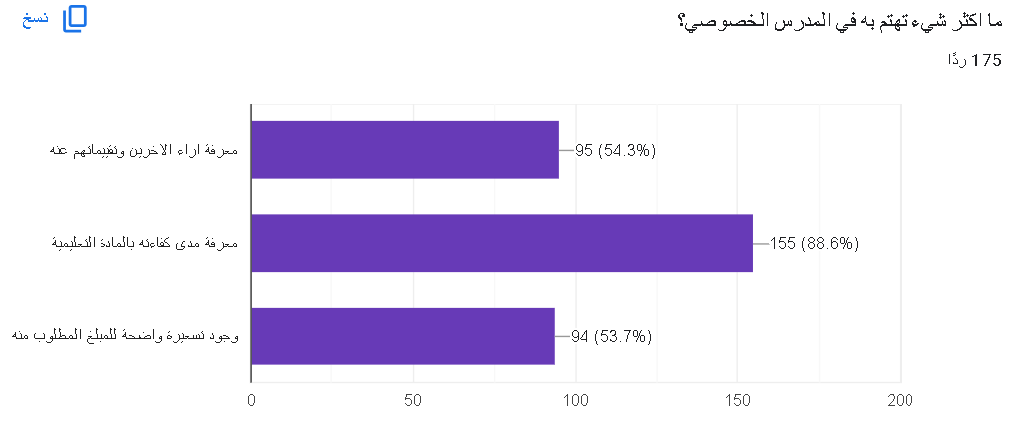
Statistics
Raghad Alasmari

Slide 10
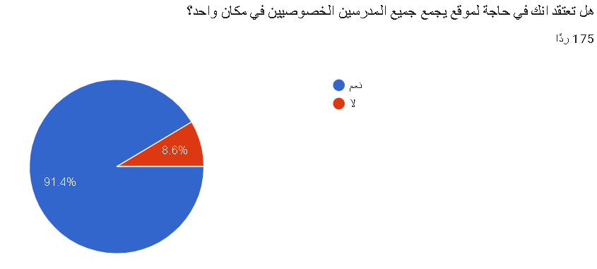
Statistics
Raghad Alasmari

Slide 11
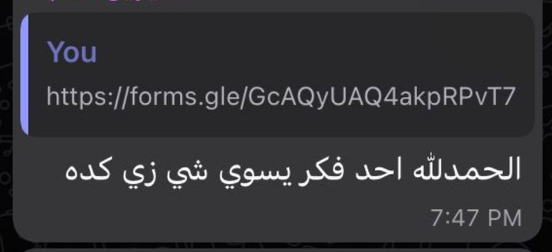

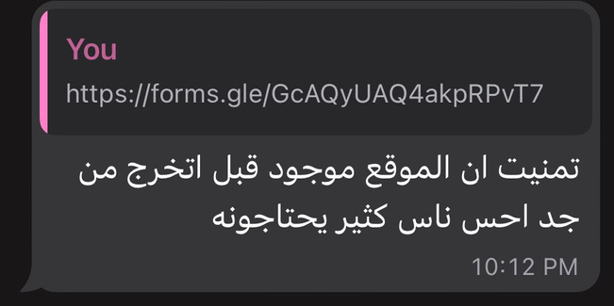
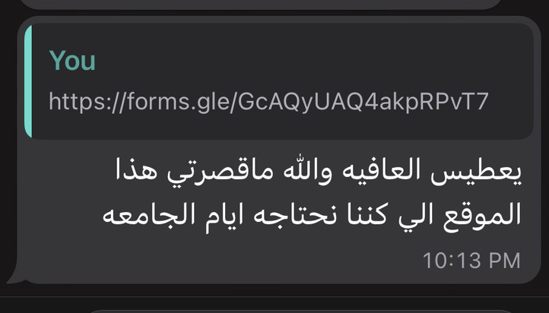
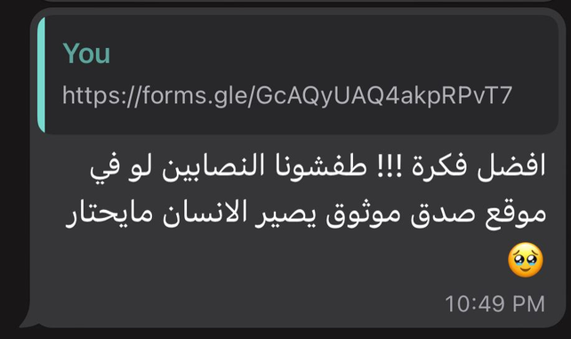
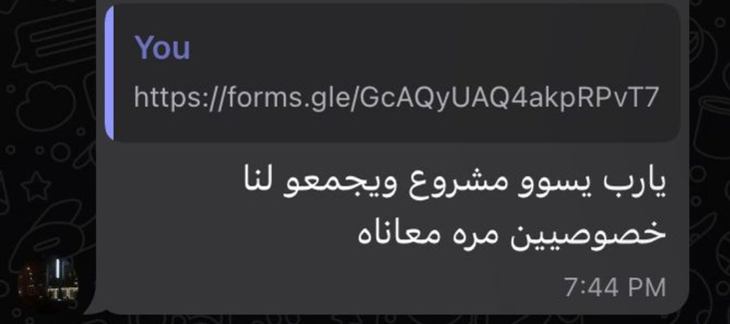
Reviews
Raghad Alasmari

Slide 12
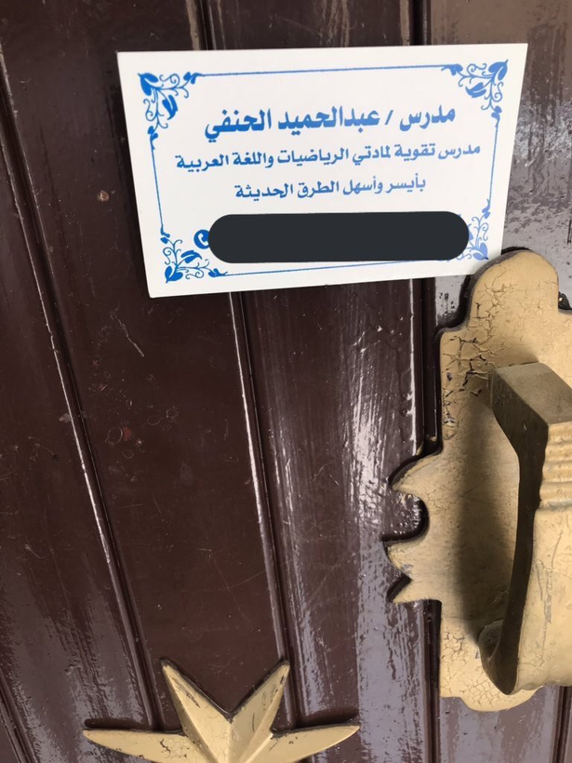
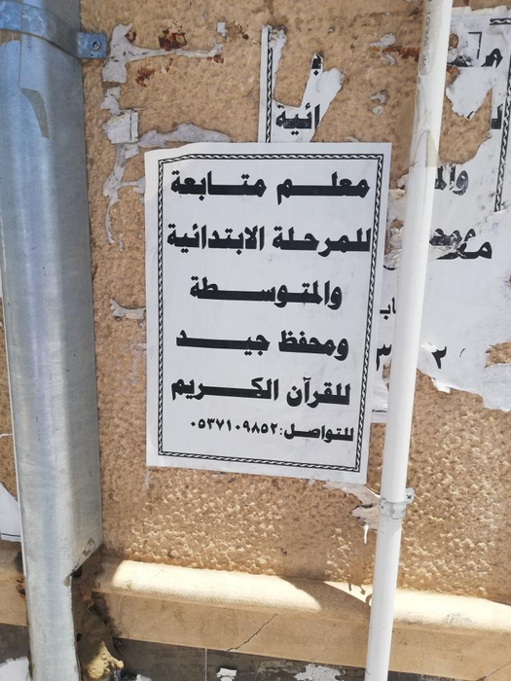
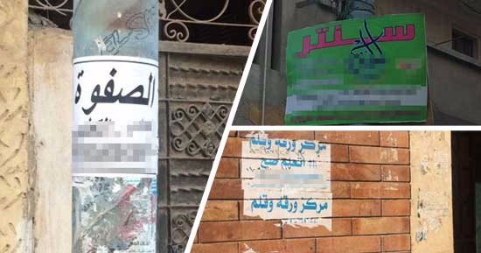
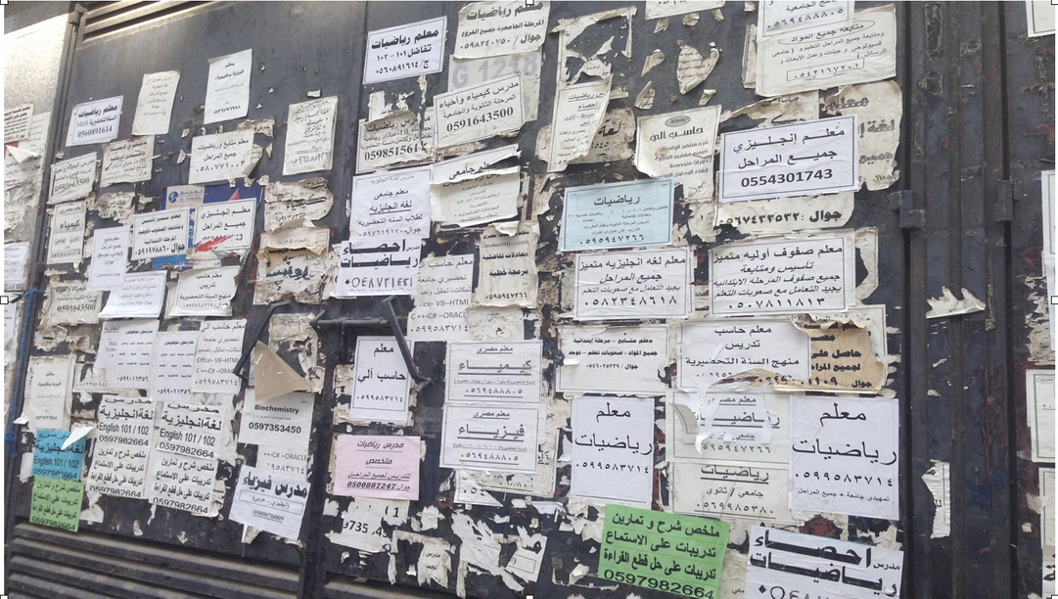

Visual Pollution

Slide 13

Twitter Review

Slide 14








Twitter

Slide 15
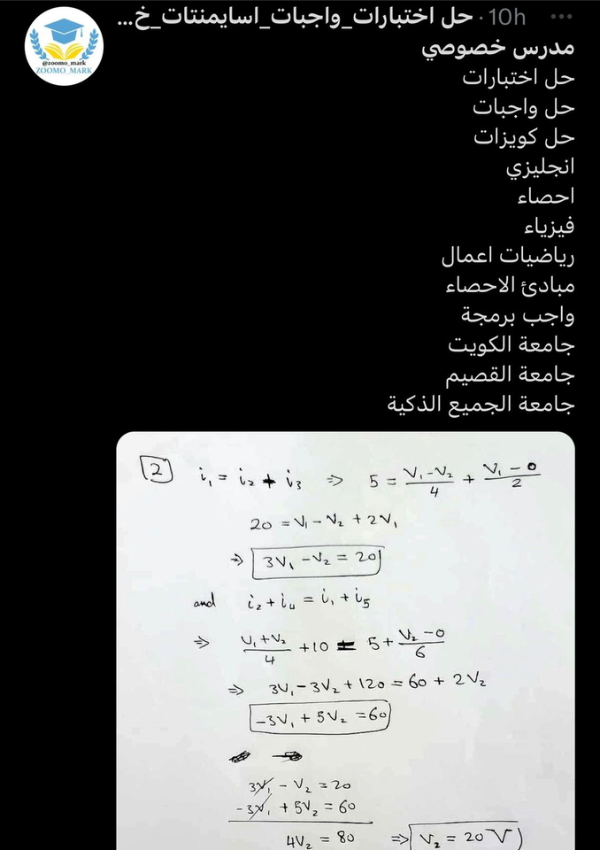


Twitter Tutors

Slide 16

Why StudySquad?
All tutors in one place
Easy access to tutors with more options
Several options for attending the class
Possibility for rating tutors
Several tutors with different prices
Ability to search for tutor by different type desire

Slide 17
Use Case Diagram
Class Diagram

Slide 18







Tools

Slide 19
Figma

Slide 20

PostMan

Slide 21
Future Work
Tipping Tutors
Adding Privileges for high rated tutors
Evaluating Tutors competence
Adding Discount Codes for students
Making Discounts for students who reserve more
Suspend student account when the cancel more than x time

Slide 22
Thank You for Listening

